Slide 1
跟IE簽約成為XSS少女吧
Make a contract with IE and become a XSS girl!
Yosuke HASEGAWA
http://utf-8.jp/

Slide 2
歉意 I'm sorry 謝罪
我從來沒有看過的動漫作品 "魔法少女小圓☆魔力"
I've never watched the anime "Puella Magi Madoka Magica"
「まどか☆マギカ」見てません

Slide 3
自我介紹 Who am I? 自己紹介
Yosuke HASEGAWA
NetAgent Co.,Ltd. R&D dept.
Secure Sky Technology Inc. technical adviser
Microsoft MVP for Consumer Security Oct 2005 -
http://utf-8.jp/
開發JavaScript的混淆工具 Writing obfuscated JavaScript

Slide 4
介紹到JavaScript的混淆 Introduction of obfuscated JavaScript

Slide 5
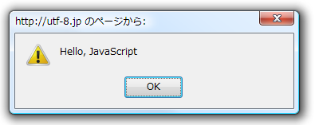
JavaScript的混淆
javascript:$=~[];$={___:++$,$$$$:(![]+"")[$],__$:++$,$_$_:(![]+"")[$],_$_:++$,$_$$:({}+"")[$],$$_$:($[$]+"")[$],_$$:++$,$$$_:(!""+"")[$],$__:++$,$_$:++$,$$__:({}+"")[$],$$_:++$,$$$:++$,$___:++$,$__$:++$};$.$_=($.$_=$+"")[$.$_$]+($._$=$.$_[$.__$])+($.$$=($.$+"")[$.__$])+((!$)+"")[$._$$]+($.__=$.$_[$.$$_])+($.$=(!""+"")[$.__$])+($._=(!""+"")[$._$_])+$.$_[$.$_$]+$.__+$._$+$.$;$.$$=$.$+(!""+"")[$._$$]+$.__+$._+$.$+$.$$;$.$=($.___)[$.$_][$.$_];$.$($.$($.$$+"\""+$.$_$_+(![]+"")[$._$_]+$.$$$_+"\\"+$.__$+$.$$_+$._$_+$.__+"(\\\"\\"+$.__$+$.__$+$.___+$.$$$_+(![]+"")[$._$_]+(![]+"")[$._$_]+$._$+", \\"+$.__$+$.__$+$._$_+$.$_$_+"\\"+$.__$+$.$$_+$.$$_+$.$_$_+"\\"+$.__$+$._$_+$._$$+$.$$__+"\\"+$.__$+$.$$_+$._$_+"\\"+$.__$+$.$_$+$.__$+"\\"+$.__$+$.$$_+$.___+$.__+"\\\" )"+"\"")())();
jjencode - http://utf-8.jp/public/jjencode.html
javascript:alert("Hello, JavaScript")

Slide 6
更多的人需要溫柔! Need ｍore friendly!

Slide 7
表情符號JavaScript JS with emoticon
ﾟωﾟﾉ= /｀ｍ´）ﾉ ~┻━┻ //*´∇｀*/ ['_']; o=(ﾟｰﾟ) =_=3; c=(ﾟΘﾟ) =(ﾟｰﾟ)-(ﾟｰﾟ); (ﾟДﾟ) =(ﾟΘﾟ)= (o^_^o)/ (o^_^o);(ﾟДﾟ)={ﾟΘﾟ: '_' ,ﾟωﾟﾉ : ((ﾟωﾟﾉ==3) +'_') [ﾟΘﾟ] ,ﾟｰﾟﾉ :(ﾟωﾟﾉ+ '_')[o^_^o -
(ﾟΘﾟ)] ,ﾟДﾟﾉ:((ﾟｰﾟ==3) +'_')[ﾟｰﾟ] }; (ﾟДﾟ) [ﾟΘﾟ] =((ﾟωﾟﾉ==3) +'_') [c^_^o];(ﾟДﾟ) ['c'] =
((ﾟДﾟ)+'_') [ (ﾟｰﾟ)+(ﾟｰﾟ)-(ﾟΘﾟ) ];(ﾟДﾟ) ['o'] = ((ﾟДﾟ)+'_') [ﾟΘﾟ];(ﾟoﾟ)=(ﾟДﾟ) ['c']+(ﾟДﾟ) ['o']+(ﾟωﾟﾉ +'_')[ﾟΘﾟ]+ ((ﾟωﾟﾉ==3) +'_') [ﾟｰﾟ] + ((ﾟДﾟ) +'_') [(ﾟｰﾟ)+(ﾟｰﾟ)]+ ((ﾟｰﾟ==3) +'_')
[ﾟΘﾟ]+((ﾟｰﾟ==3) +'_') [(ﾟｰﾟ) - (ﾟΘﾟ)]+(ﾟДﾟ) ['c']+((ﾟДﾟ)+'_') [(ﾟｰﾟ)+(ﾟｰﾟ)]+ (ﾟДﾟ) ['o']+
((ﾟｰﾟ==3) +'_') [ﾟΘﾟ];(ﾟДﾟ) ['_'] =(o^_^o) [ﾟoﾟ] [ﾟoﾟ];(ﾟεﾟ)=((ﾟｰﾟ==3) +'_') [ﾟΘﾟ]+ (ﾟДﾟ) .ﾟДﾟﾉ+((ﾟДﾟ)+'_') [(ﾟｰﾟ) + (ﾟｰﾟ)]+((ﾟｰﾟ==3) +'_') [o^_^o -ﾟΘﾟ]+((ﾟｰﾟ==3) +'_') [ﾟΘﾟ]+ (ﾟωﾟﾉ +'_')
[ﾟΘﾟ]; (ﾟｰﾟ)+=(ﾟΘﾟ); (ﾟДﾟ)[ﾟεﾟ]='\\'; (ﾟДﾟ).ﾟΘﾟﾉ=(ﾟДﾟ+ ﾟｰﾟ)[o^_^o -(ﾟΘﾟ)];(oﾟｰﾟo)=(ﾟωﾟﾉ +'_')[c^_^o];(ﾟДﾟ) [ﾟoﾟ]='\"';(ﾟДﾟ) ['_'] ( (ﾟДﾟ) ['_'] (ﾟεﾟ+(ﾟДﾟ)[ﾟoﾟ]+ (ﾟДﾟ)[ﾟεﾟ]+(ﾟΘﾟ)+ (ﾟｰﾟ)+ (ﾟΘﾟ)+ (ﾟДﾟ)[ﾟεﾟ]+(ﾟΘﾟ)+ ((ﾟｰﾟ) + (ﾟΘﾟ))+ (ﾟｰﾟ)+ (ﾟДﾟ)[ﾟεﾟ]+(ﾟΘﾟ)+ (ﾟｰﾟ)+ ((ﾟｰﾟ) +
(ﾟΘﾟ))+ (ﾟДﾟ)[ﾟεﾟ]+(ﾟΘﾟ)+ ((o^_^o) +(o^_^o))+ ((o^_^o) - (ﾟΘﾟ))+ (ﾟДﾟ)[ﾟεﾟ]+(ﾟΘﾟ)+ ((o^_^o) +(o^_^o))+ (ﾟｰﾟ)+ (ﾟДﾟ)[ﾟεﾟ]+((ﾟｰﾟ) + (ﾟΘﾟ))+ (c^_^o)+ (ﾟДﾟ)[ﾟεﾟ]+(ﾟｰﾟ)+ ((o^_^o) - (ﾟΘﾟ))+
(ﾟДﾟ)[ﾟεﾟ]+(ﾟΘﾟ)+ (ﾟΘﾟ)+ (c^_^o)+ (ﾟДﾟ)[ﾟεﾟ]+(ﾟΘﾟ)+ (ﾟｰﾟ)+ ((ﾟｰﾟ) + (ﾟΘﾟ))+ (ﾟДﾟ)[ﾟεﾟ]+(ﾟΘﾟ)+ ((ﾟｰﾟ) + (ﾟΘﾟ))+ (ﾟｰﾟ)+ (ﾟДﾟ)[ﾟεﾟ]+(ﾟΘﾟ)+ ((ﾟｰﾟ) + (ﾟΘﾟ))+ (ﾟｰﾟ)+ (ﾟДﾟ)[ﾟεﾟ]+(ﾟΘﾟ)+ ((ﾟｰﾟ) + (ﾟΘﾟ))+ ((ﾟｰﾟ) + (o^_^o))+ (ﾟДﾟ)[ﾟεﾟ]+((ﾟｰﾟ) + (ﾟΘﾟ))+ (ﾟｰﾟ)+ (ﾟДﾟ)[ﾟεﾟ]+(ﾟｰﾟ)+ (c^_^o)+ (ﾟДﾟ)[ﾟεﾟ]+(ﾟΘﾟ)+ (ﾟΘﾟ)+ ((o^_^o) - (ﾟΘﾟ))+ (ﾟДﾟ)[ﾟεﾟ]+(ﾟΘﾟ)+ (ﾟｰﾟ)+ (ﾟΘﾟ)+
(ﾟДﾟ)[ﾟεﾟ]+(ﾟΘﾟ)+ ((o^_^o) +(o^_^o))+ ((o^_^o) +(o^_^o))+ (ﾟДﾟ)[ﾟεﾟ]+(ﾟΘﾟ)+ (ﾟｰﾟ)+ (ﾟΘﾟ)+
(ﾟДﾟ)[ﾟεﾟ]+(ﾟΘﾟ)+ ((o^_^o) - (ﾟΘﾟ))+ (o^_^o)+ (ﾟДﾟ)[ﾟεﾟ]+(ﾟΘﾟ)+ (ﾟｰﾟ)+ (o^_^o)+ (ﾟДﾟ)[ﾟεﾟ]+(ﾟΘﾟ)+ ((o^_^o) +(o^_^o))+ ((o^_^o) - (ﾟΘﾟ))+ (ﾟДﾟ)[ﾟεﾟ]+(ﾟΘﾟ)+ ((ﾟｰﾟ) + (ﾟΘﾟ))+ (ﾟΘﾟ)+ (ﾟДﾟ)[ﾟεﾟ]+(ﾟΘﾟ)+ ((o^_^o) +(o^_^o))+ (c^_^o)+ (ﾟДﾟ)[ﾟεﾟ]+(ﾟΘﾟ)+ ((o^_^o) +(o^_^o))+ (ﾟｰﾟ)+
(ﾟДﾟ)[ﾟεﾟ]+(ﾟｰﾟ)+ ((o^_^o) - (ﾟΘﾟ))+ (ﾟДﾟ)[ﾟεﾟ]+((ﾟｰﾟ) + (ﾟΘﾟ))+ (ﾟΘﾟ)+ (ﾟДﾟ)[ﾟoﾟ]) (ﾟΘﾟ)) ('_');
aaencode - http://utf-8.jp/public/aaencode.html

Slide 8
今天的主要話題 Today's topic

Slide 9
今天的主要話題 Today's topic
開發瀏覽器的競爭，已經發布了新版本的每一天 Heating up developing race of browsers, New version of browsers are released day by day.
ブラウザの開発競争が過熱し、新バージョンのブラウザが毎日のようにリリースされる

Slide 10
今天的主要話題 Today's topic
舊版本的漏洞被忽視了很久，雖然在此期間的支持 Vulnerabilities of old versions are neglected for a long time, although during the period of support.
サポート期間中であるにも関わらず、古いバージョンの脆弱性は長い間放置される。

Slide 11
今天的主要話題 Today's topic
尤其是微軟公司. 在IE6-8瀏覽器已滿的問題，導致 XSS. Especially Microsoft. There're many vulns on IE6-8 that causes XSS.
特にMicrosoft。IE6-8はXSSにつながる問題がたくさん。

Slide 12
第1話 忽視 Content-Type 標頭 Episode 1: Ignoring Content-Type Header

Slide 13
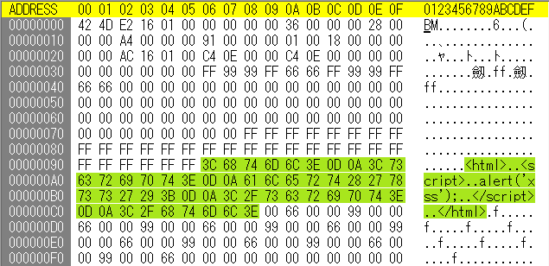
忽視 Content-Type 標頭 Ignoring Content-Type Header
壞習慣從昔日的IE Bad habit of IE from old days
升降無 HTML為 HTML原因XSS Elevating no-HTML to HTML causes XSS.
昔からのIEの悪癖
HTMLではないものがHTMLに昇格してXSS

Slide 14
忽視 Content-Type 標頭 Ignoring Content-Type Header
IE的決定 FILE TYPE 的內容由幾個因素, 不僅 Content-Type. IE decides FILE TYPE of the content by several factors, not only "Content-Type"
複雜的機制,無證 Complicated mechanism, undocumented.
IEはContent-Typeだけでなく、様々な要因からファイルタイプを決定
文書化されていない複雑なメカニズム

Slide 15
忽視 Content-Type 標頭 Ignoring Content-Type Header
FILE TYPE決定因素 Factors for deciding
"Content-Type" HTTP 標頭
"X-Content-Type-Option" HTTP 標頭
Association information on Windows 登錄機
IE configuration:"根據內容開啓檔案而不是根據副檔名" "Open files based on content, not file extension"
URL itself
Contents body itself

Slide 16
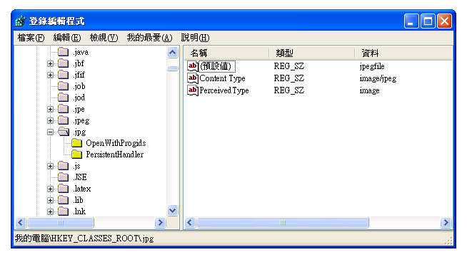
忽視 Content-Type 標頭 Ignoring Content-Type Header
FILE TYPE決定因素 Factors for deciding
"Content-Type" HTTP 標頭
"X-Content-Type-Option" HTTP 標頭
Association information on Windows 登錄機
IE configuration:"根據內容開啓檔案而不是根據副檔名" "Open files based on content, not file extension"
URL itself
Contents body itself

Slide 17
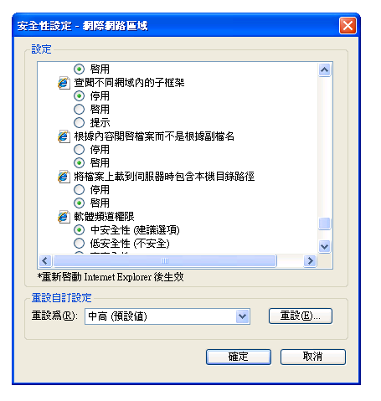
忽視 Content-Type 標頭 Ignoring Content-Type Header
FILE TYPE決定因素 Factors for deciding
"Content-Type" HTTP 標頭
"X-Content-Type-Option" HTTP 標頭
Association information on Windows 登錄機
IE configuration:"根據內容開啓檔案而不是根據副檔名" "Open files based on content, not file extension"
URL itself
Contents body itself

Slide 18
忽視 Content-Type 標頭 Ignoring Content-Type Header
FILE TYPE決定因素 Factors for deciding
"Content-Type" HTTP 標頭
"X-Content-Type-Option" HTTP 標頭
Association information on Windows 登錄機
IE configuration:"根據內容開啓檔案而不是根據副檔名" "Open files based on content, not file extension"
URL itself
Contents body itself

Slide 19
機制來確定文件類型的IE Mechanism to determine file type of IE
Content-Type is registered in Registry? [ HKEY_CLASSES_ROOT\MIME\Database\Content Type ]
Y
N
determine tentative file-type
IE8+ && "X-Content-Type-Options:nosniff"?
Y
N
need external plugin/apps?
Y
launch plugin or download
download
N
IE8+ && "X-Content-Type-Options:nosniff"?
Y
use tentative file-type
N
"Open files based on content, not file extension"
Enabled
sniff content and determine file-type
Disabled
use tentative file-type
Extension of URL is ".cgi" or ".exe" or nothing( "/" ) ? e.g. http://utf-8.jp/a.cgi?abcd
Y
N
determine tentative file-type by QUERY_STRING
determine tentative file-type by extension of URL
need external plugin/apps?
need external plugin/apps?
N
Y
N
Y
sniff content and determine file-type
launch plugin or download
sniff content and determine file-type
launch plugin or download
In addition to these, there're some exceptions.
Yosuke HASEGAWA http://utf-8.jp/

Slide 20
機制來確定文件類型的IE Mechanism to determine file type of IE
Content-Type is registered in Registry? [ HKEY_CLASSES_ROOT\MIME\Database\Content Type ]
Y
N
determine tentative file-type
IE8+ && "X-Content-Type-Options:nosniff"?
Y
N
need external plugin/apps?
Y
launch plugin or download
download
N
IE8+ && "X-Content-Type-Options:nosniff"?
Y
use tentative file-type
N
"Open files based on content, not file extension"
Enabled
sniff content and determine file-type
Disabled
use tentative file-type
Extension of URL is ".cgi" or ".exe" or nothing( "/" ) ? e.g. http://utf-8.jp/a.cgi?abcd
Y
N
determine tentative file-type by QUERY_STRING
determine tentative file-type by extension of URL
need external plugin/apps?
need external plugin/apps?
N
Y
N
Y
sniff content and determine file-type
launch plugin or download
sniff content and determine file-type
launch plugin or download
In addition to these, there're some exceptions.
Yosuke HASEGAWA http://utf-8.jp/

Slide 21
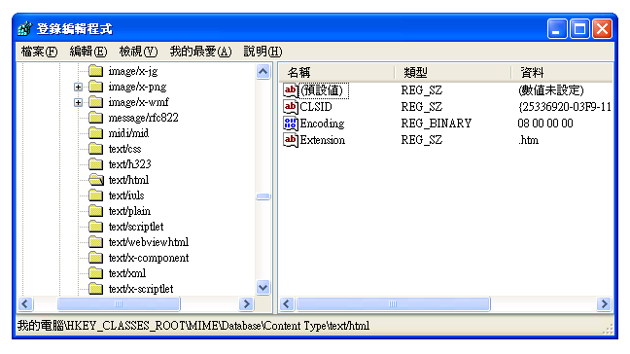
機制來確定文件類型的IE Mechanism to determine file type of IE
Content-Type中註冊登錄機? Content-Type is registered in Registry?
Content-Typeがレジストリに登録されているか

Slide 22
機制來確定文件類型的IE Mechanism to determine file type of IE
Content-Type is registered in Registry? [ HKEY_CLASSES_ROOT\MIME\Database\Content Type ]
Y
N
determine tentative file-type
IE8+ && "X-Content-Type-Options:nosniff"?
Y
N
need external plugin/apps?
Y
launch plugin or download
download
N
IE8+ && "X-Content-Type-Options:nosniff"?
Y
use tentative file-type
N
"Open files based on content, not file extension"
Enabled
sniff content and determine file-type
Disabled
use tentative file-type
Extension of URL is ".cgi" or ".exe" or nothing( "/" ) ? e.g. http://utf-8.jp/a.cgi?abcd
Y
N
determine tentative file-type by QUERY_STRING
determine tentative file-type by extension of URL
need external plugin/apps?
need external plugin/apps?
N
Y
N
Y
sniff content and determine file-type
launch plugin or download
sniff content and determine file-type
launch plugin or download
In addition to these, there're some exceptions.
Yosuke HASEGAWA http://utf-8.jp/

Slide 23
機制來確定文件類型的IE Mechanism to determine file type of IE
IE configuration:"根據內容開啓檔案而不是根據副檔名"
"Open files based on content, not file extension"
「拡張子ではなく、内容によってファイルを開く」

Slide 24
機制來確定文件類型的IE Mechanism to determine file type of IE
Content-Type is registered in Registry? [ HKEY_CLASSES_ROOT\MIME\Database\Content Type ]
Y
N
determine tentative file-type
IE8+ && "X-Content-Type-Options:nosniff"?
Y
N
need external plugin/apps?
Y
launch plugin or download
download
N
IE8+ && "X-Content-Type-Options:nosniff"?
Y
use tentative file-type
N
"Open files based on content, not file extension"
Enabled
sniff content and determine file-type
Disabled
use tentative file-type
Extension of URL is ".cgi" or ".exe" or nothing( "/" ) ? e.g. http://utf-8.jp/a.cgi?abcd
Y
N
determine tentative file-type by QUERY_STRING
determine tentative file-type by extension of URL
need external plugin/apps?
need external plugin/apps?
N
Y
N
Y
sniff content and determine file-type
launch plugin or download
sniff content and determine file-type
launch plugin or download
In addition to these, there're some exceptions.
Yosuke HASEGAWA http://utf-8.jp/

Slide 25
機制來確定文件類型的IE Mechanism to determine file type of IE
嗅探內容，並確定文件類型 Sniff content and determine file-type.
コンテンツの内容によってファイルタイプを決定
Content-Type: image/bmp

Slide 26
機制來確定文件類型的IE Mechanism to determine file type of IE
Content-Type is registered in Registry? [ HKEY_CLASSES_ROOT\MIME\Database\Content Type ]
Y
N
determine tentative file-type
IE8+ && "X-Content-Type-Options:nosniff"?
Y
N
need external plugin/apps?
Y
launch plugin or download
download
N
IE8+ && "X-Content-Type-Options:nosniff"?
Y
use tentative file-type
N
"Open files based on content, not file extension"
Enabled
sniff content and determine file-type
Disabled
use tentative file-type
Extension of URL is ".cgi" or ".exe" or nothing( "/" ) ? e.g. http://utf-8.jp/a.cgi?abcd
Y
N
determine tentative file-type by QUERY_STRING
determine tentative file-type by extension of URL
need external plugin/apps?
need external plugin/apps?
N
Y
N
Y
sniff content and determine file-type
launch plugin or download
sniff content and determine file-type
launch plugin or download
In addition to these, there're some exceptions.
Yosuke HASEGAWA http://utf-8.jp/

Slide 27
機制來確定文件類型的IE Mechanism to determine file type of IE
Content-Type is registered in Registry? [ HKEY_CLASSES_ROOT\MIME\Database\Content Type ]
Y
N
determine tentative file-type
IE8+ && "X-Content-Type-Options:nosniff"?
Y
N
need external plugin/apps?
Y
launch plugin or download
download
N
IE8+ && "X-Content-Type-Options:nosniff"?
Y
use tentative file-type
N
"Open files based on content, not file extension"
Enabled
sniff content and determine file-type
Disabled
use tentative file-type
Extension of URL is ".cgi" or ".exe" or nothing( "/" ) ? e.g. http://utf-8.jp/a.cgi?abcd
Y
N
determine tentative file-type by QUERY_STRING
determine tentative file-type by extension of URL
need external plugin/apps?
need external plugin/apps?
N
Y
N
Y
sniff content and determine file-type
launch plugin or download
sniff content and determine file-type
launch plugin or download
In addition to these, there're some exceptions.
Yosuke HASEGAWA http://utf-8.jp/

Slide 28
機制來確定文件類型的IE Mechanism to determine file type of IE
網址的副檔名, QUERY_STRING Extension of URL, QUERY_STRING
URLの拡張子, QUERY_STRING
http://example.jp/foo.cgi?param=abc&a.html
http://example.jp/foo.exe?param=abc&a.html
http://example.jp/foo?param=abc&a.html
http://example.jp/foo/?param=abc&a.html
filetype == html
http://example.jp/foo.php?param=abc&a.html
filetype != html
http://example.jp/foo.php/a.html?param=abc
filetype == html

Slide 29
機制來確定文件類型的IE Mechanism to determine file type of IE
反正是複雜的! Anyway, Complicated!
とにかく複雑

Slide 30
XSS案例 Case example
https://www.microsoft.com/en-us/homepage/ bimapping.js/a.html?v=<script>alert(1)</script>&k...
HTTP/1.1 200 OK
Content-Type: text/javascript; charset=utf-8
Date: Wed, 22 Jun 2011 13:53:37 GMT
Content-Length: 2092
var <script>alert(1)</script>={"Webtrends":{"enabled":true,"sett ings":{"interactiontype":{"0":true,"1":true,"2":true,"3":true,"4":t rue,"5":true,"6":true,"7":true,"8":true,"9":true,"10":true,"11":tr ue,"12":true,"13"....
"text/javascript" is not registered in Registry

Slide 31
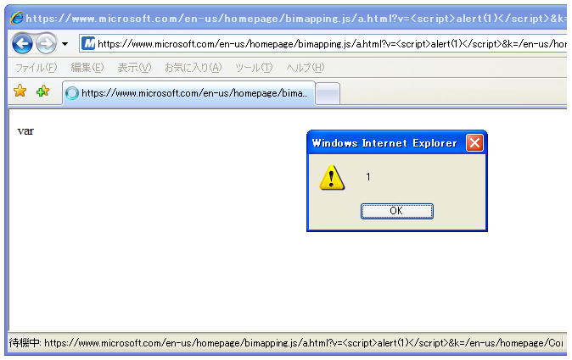
XSS案例 Case example
https://www.microsoft.com/en-us/homepage/ bimapping.js/a.html?v=<script>alert(1)</script>&k...
HTTP/1.1 200 OK
Content-Type: text/javascript; charset=utf-8
Date: Wed, 22 Jun 2011 13:53:37 GMT
Content-Length: 2092
var <script>alert(1)</script>={"Webtrends":{"enabled":true,"sett ings":{"interactiontype":{"0":true,"1":true,"2":true,"3":true,"4":t rue,"5":true,"6":true,"7":true,"8":true,"9":true,"10":true,"11":tr ue,"12":true,"13"....
"text/javascript" is not registered in Registry

Slide 32
機制來確定文件類型的IE Mechanism to determine file type of IE
対策 Countermeasure
Use "X-Content-Type- Options:nosniff" (only for IE8+)
Use only well-known Content-Type. don't use "text/javascript".

Slide 33
第2話 旁路 Content-Disposition 標頭 Episode 2: Bypass Content-Disposition Header

Slide 34
旁路 Content-Disposition 標頭 Bypass Content-Dispositon Header
Content-Disposition: attachment
下載指令的瀏覽器 Download directive for browsers ブラウザへのダウンロード指令
經常使用，以防止對 XSS often uses for preventing for XSS
XSSを防ぐために使用される。

Slide 35
旁路 Content-Disposition 標頭 Bypass Content-Dispositon Header
Content-Disposition: attachment
旁路'Content-Disposition: attachment' 與攻擊者通過特製的JavaScript Bypass 'Content-Disposition: attachment' with specially crafted JavaScript by attacker 攻撃者の細工したJavaScriptにより'Content-Disposition: attachment'を回避可能

Slide 36
旁路 Content-Disposition 標頭 Bypass Content-Dispositon Header
陷阱頁面創建的攻擊者 Trap page by attacker
<script>
// crafted JavaScript here.
// actual code is not open today
// 今天沒有顯示。 ^_^;
</script>
<script src="http://example.com/download.cgi"></script>
目標內容與 "Content-Disposition: attachment"
target content with "Content-Disposition: attachment"

Slide 37
旁路 Content-Disposition 標頭 Bypass Content-Dispositon Header
悄悄地發表於2007年7月在日本 Published: Jul 2007 in Javap by stealth 2007年7月に日本でひっそりと公開
Affected: IE6 / IE7 / IE8
沒辦法，以防止XSS由服務器端。 No way to prevent XSS by server-side. サーバ側でXSSを防ぐ手段はない

Slide 38
第3話 MLang編碼轉換問題 Episode 3: MLang encode conversion issue

Slide 39
MLang編碼轉換問題 MLang encode conversion issue
MLang: DLL多語言支持，包括文字編碼轉換 MLang : DLL for multi language support including conversion of text encoding. MLangは文字エンコーディングの変換機能を含む、多言語サポートのためのDLL
ConvertINetMultiByteToUnicode
ConvertINetUnicodeToMultiByte
ConvertINetString

Slide 40
MLang編碼轉換問題 MLang encode conversion issue
IE處理文本與 Unicode的轉換，從外部通過 MLang IE handles text as Unicode from outside with conversion by MLang. IEはMLangを使って外部からの文字列をUnicodeに変換して処理
Shift_JIS,
EUC-KR,
Big5 …
MLang
<html>
UTF-16LE

Slide 41
MLang編碼轉換問題 MLang encode conversion issue
它轉換為 Unicode時給予相應破字節序列 Converted to Unicode accordingly when given broken byte sequence. 壊れたバイト列を渡したときも、それなりにUnicodeに変換される
元字符("<>)不存在於原始字節序列生成 meta characters ("<>) which don't exist in original byte sequence are generated もとのバイト列に存在しない「"<>」などが生成され、XSSにつながる

Slide 42
MLang編碼轉換問題 MLang encode conversion issue
<meta http-equiv="Content-Type"
content="text/html; charset=XXXXX" />
...
<input type="text" value=
"(0xNN)(0xNN)(0xNN)onmouseover=alert(1)// (0xNN)(0xNN)(0xNN)"
>
“0xNN”是無效的字節序列的字符集 "XXXXX" "NN" are invalid byte sequence for charset "XXXXX"
<input type="text" value="??"onmouseover=alert(1)// ??"" >

Slide 43
MLang編碼轉換問題 MLang encode conversion issue
太硬，以防止XSS此問題由服務器端 too hard to prevent XSS for this issue by server-side. サーバ側でこの問題に対処するのたいへん
驗證所有字母/字節的字符集編碼 validate all letters/bytes as the charset encoding 文字エンコーディング として適切か全文字/全バイトを検証

Slide 44
MLang編碼轉換問題 MLang encode conversion issue
現在沒有公佈細節 Not published for details now. 現状は詳細は非公開
Affected: IE6, IE7 IE8 : fixed
報告: 2007年10月 Reported: Oct 2007

Slide 45
結論 Conclusion

Slide 46
結論 Conclusion
有很多種方法只對 IE瀏覽器出現 XSS There're many ways to arise XSS only for IE IEのみでXSSを発生させる方法がたくさんある
特別是IE6/7。不是固定的很長一段時間 Especially IE6/7. not fixed for a long time. 特にIE6/7。長い間修正されていない。
重要：IE女孩在Microsoft Important: There's no IE girl in Microsoft 重要: MicrosoftにIE少女がいない

Slide 47
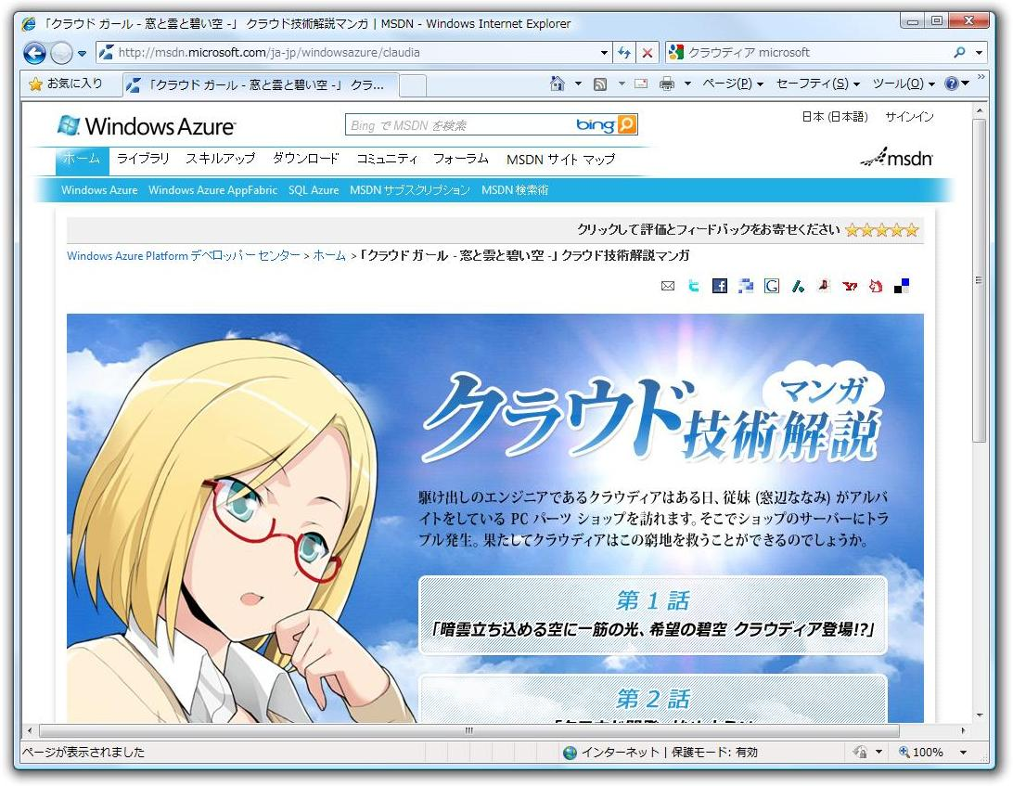
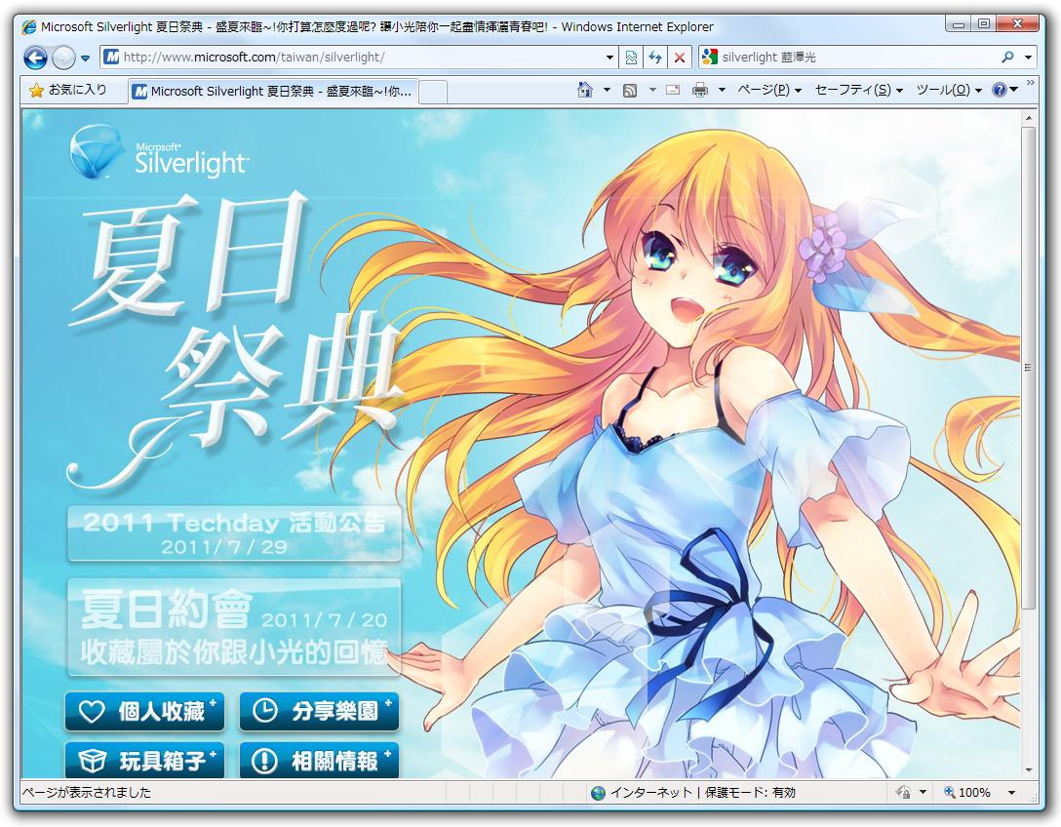
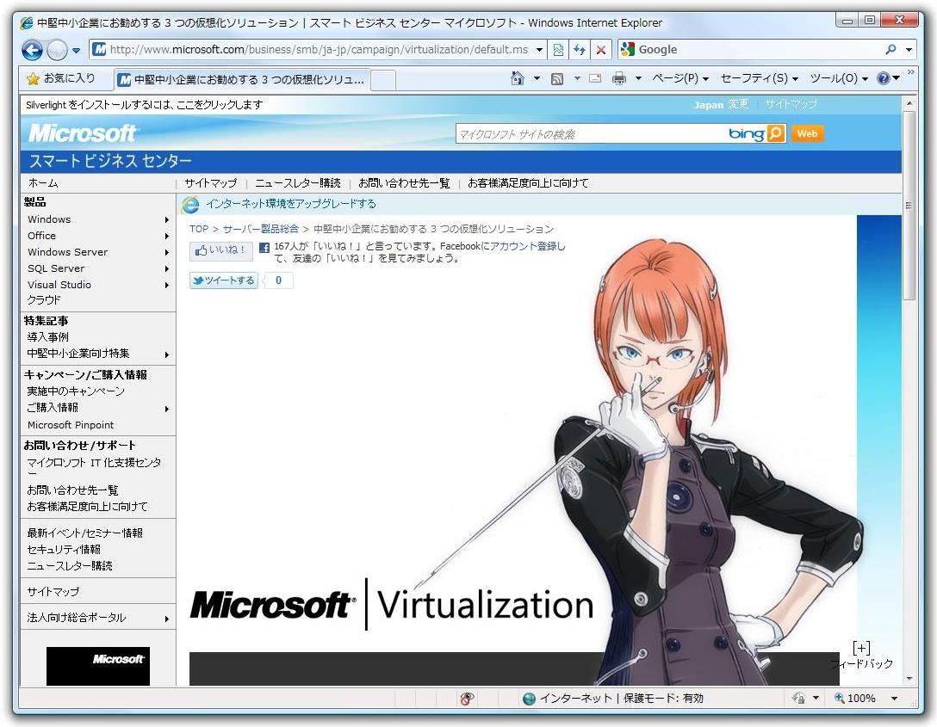
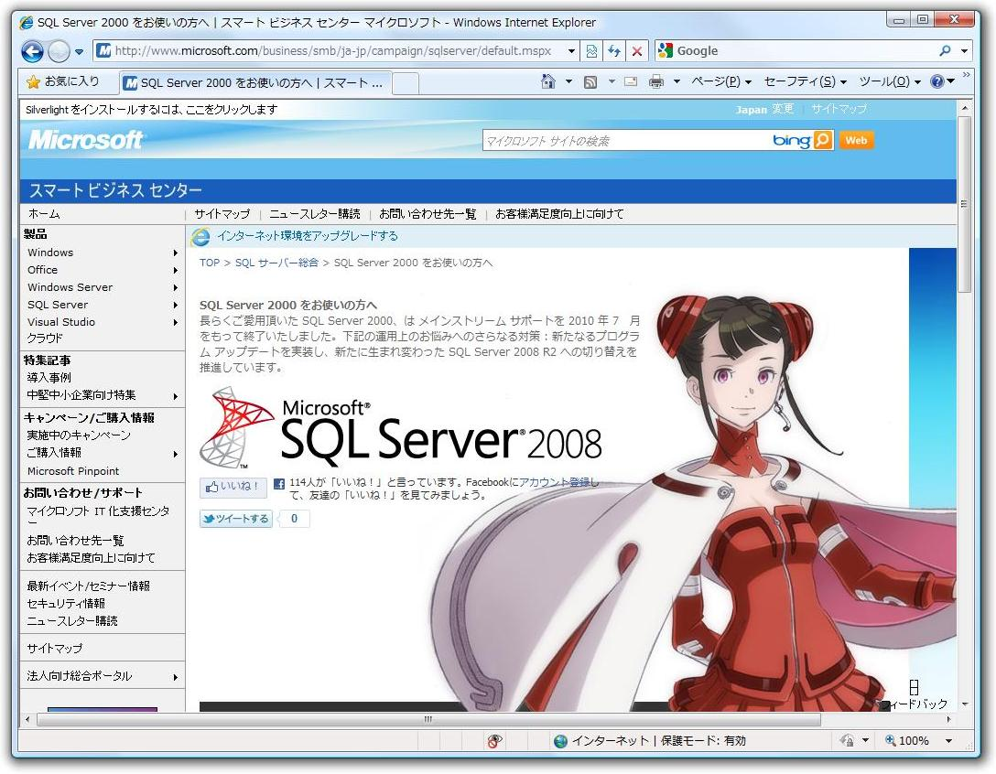
Windows Azure
Silverlight
There's no IE girl in Microsoft :(
沒有IE女孩在Microsoft :(
Virtualization
SQL Server

Slide 48
謝謝! Thanks!
David Ross and MSRC for helpful suggestions.
Google Translate for 這翻譯的文字 ^_^
… and You! Thank you for your attention.

Slide 49
任何問題? Question?
Mail
hasegawa@utf-8.jp
hasegawa@netagent.co.jp
Twitter
@hasegawayosuke
Web site
http://utf-8.jp/

